Slide 1
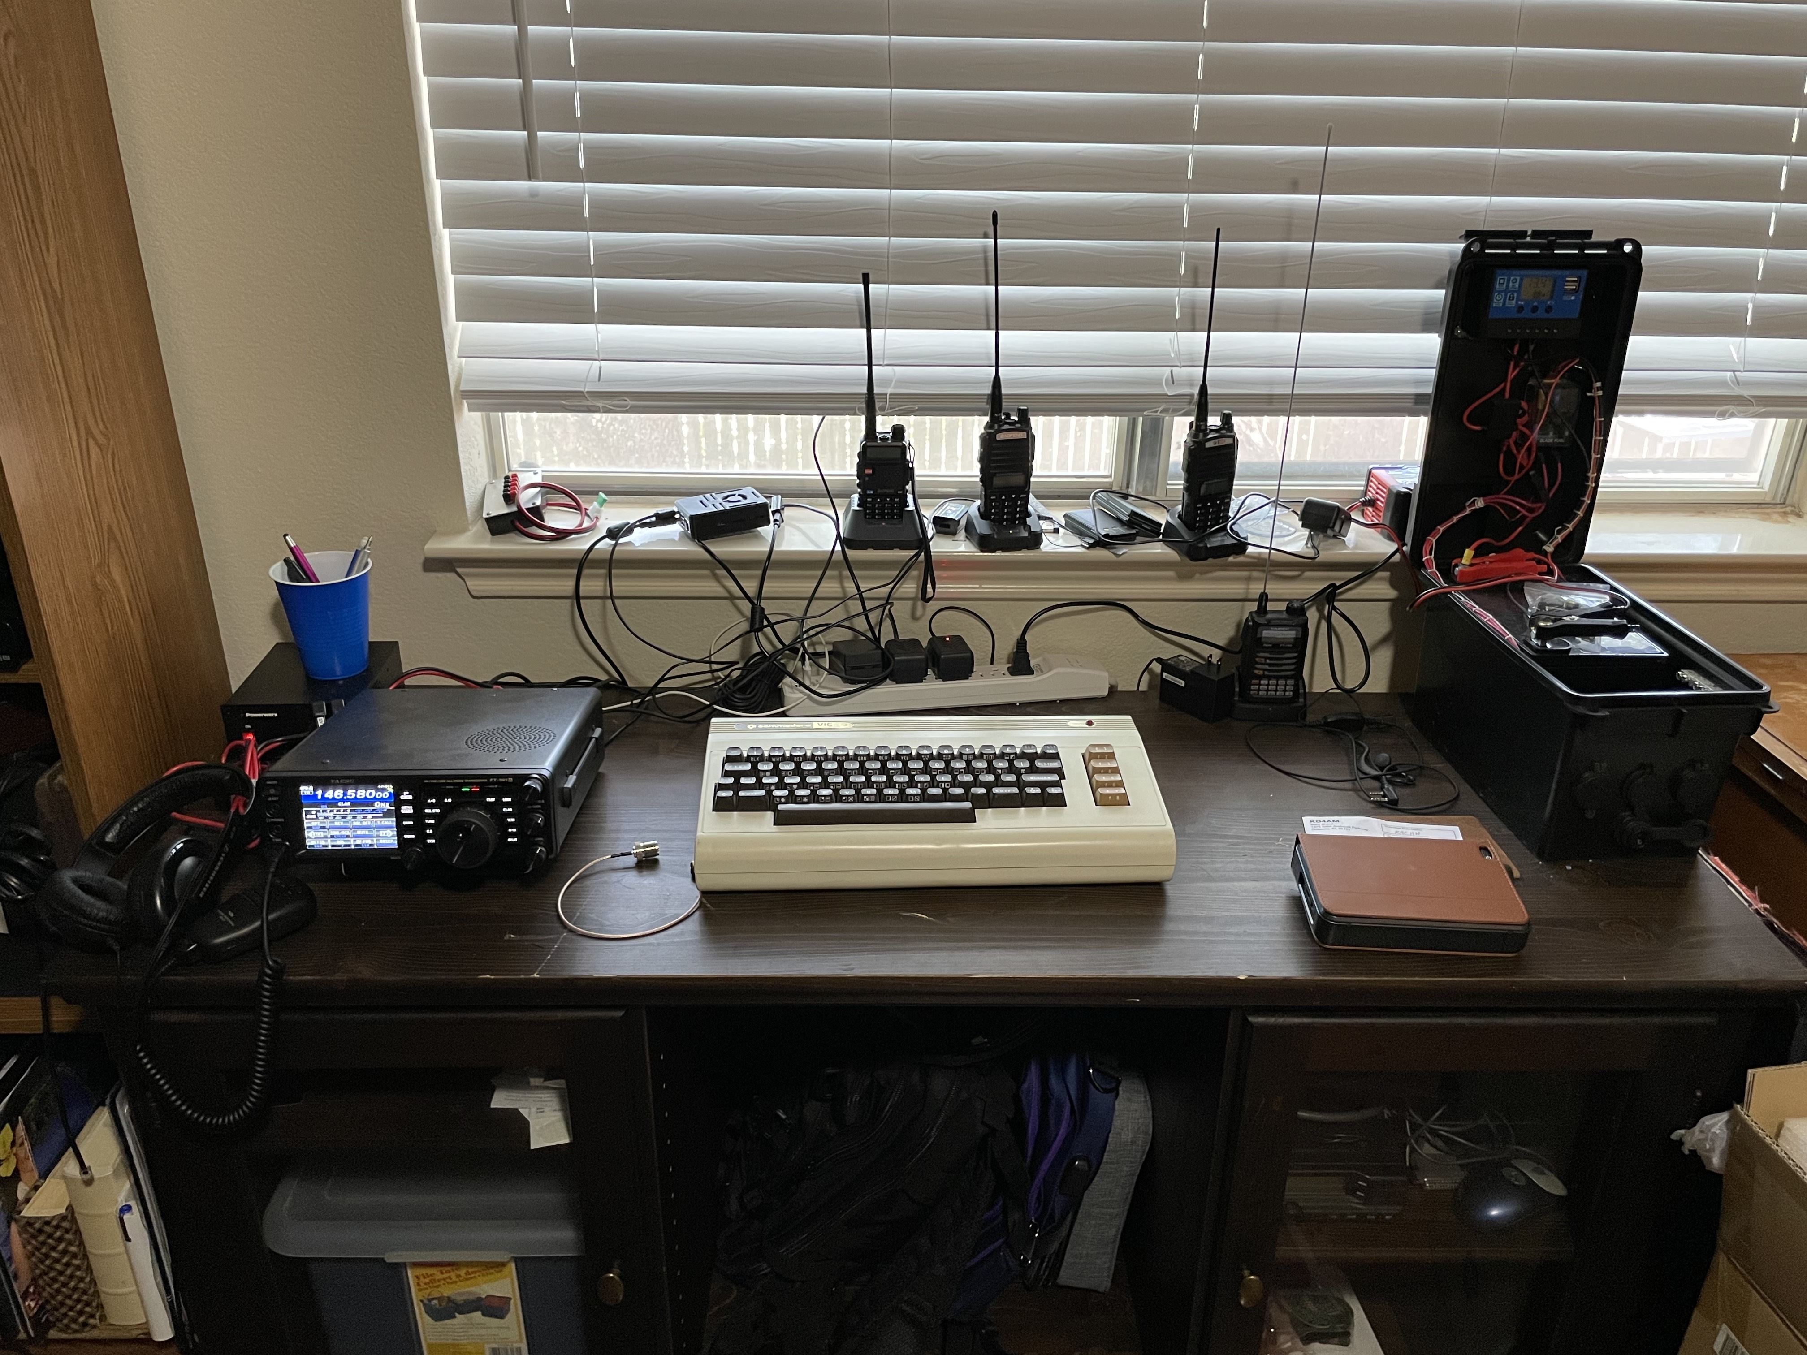
Amateur Radio
Ham Nets 101
Jon Marler - K4CHN - August 2022
Introduction to amateur radio ham nets for new and old hams

Slide 2

K4CHN / Jon Marler
Amateur Radio Operator / Hacker
Passed Technician @ DefCon 27
Passed General @ DefCon 28
Passed Extra @ DefCon 29
Vintage computer nerd
Breaker and fixer of all things
🎳 🥌

Slide 3

Presentation Agenda
Amateur Radio Digital Modes Primer
?
What is a Ham Net
Directed / Unirected
How to get started

Slide 4
What is a Ham Net?
What is an amateur radio ham net?
Notes:
A gathering of ham radio operators “on-the-air” working together. Typically all on the same frequency, but also very often done through the use of repeaters

Slide 5
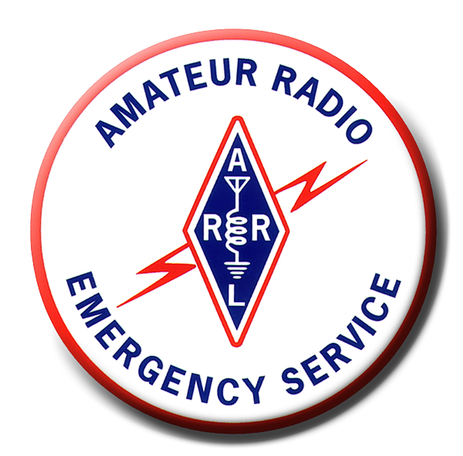




Directed Ham Nets
What is a directed / controlled ham net?
Network Control Station (NCS)
Rules, Protocols, and Procedures
Registering
Checking in
Logging QSOs
Notes:
Amateur Radio Emergency Services (ARES), SkyWarn, Radio Amateur Civil Emergency Service (RACES) , club nets, Amateur Radio Public Service Corps (APRSC), Traffic nets (National Traffic System/NTS)

Slide 6
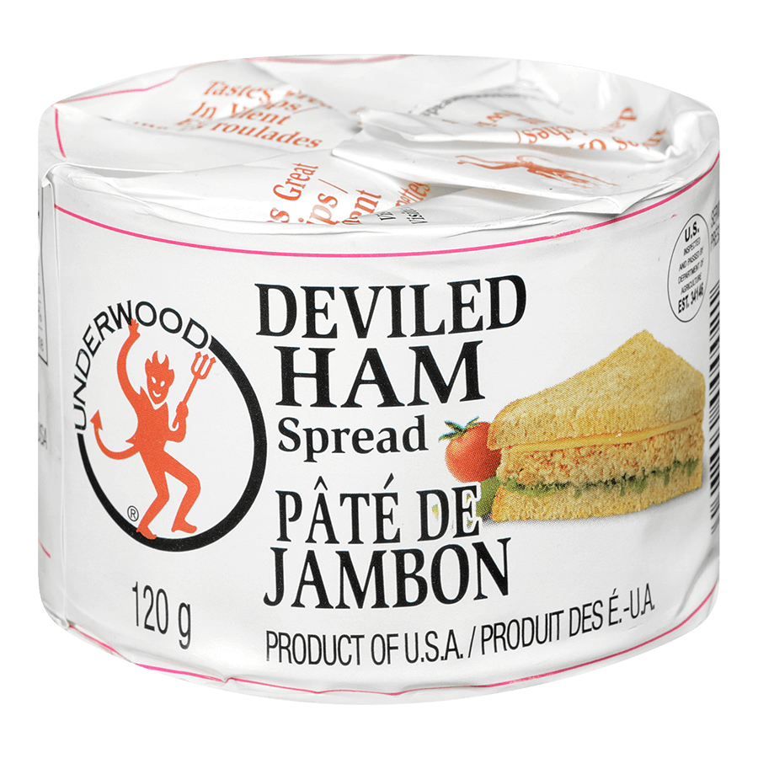

Undirected / Uncontrolled Nets
What is an undirected net?
No NCS/NCO
Rules, Protocols, and Procedures (LOL)
Events
Listen before you broadcast
DefCon (and others) con net
146.580 (Simplex)

Slide 7
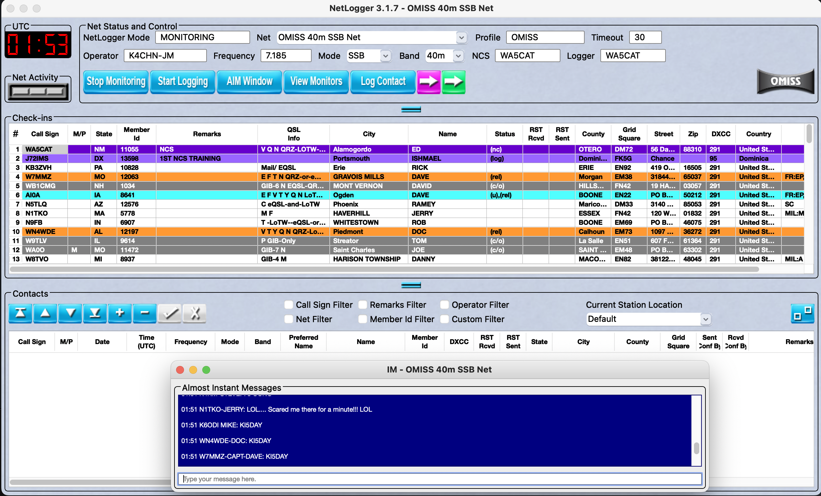
How to get started
Easy mode - NetLogger - www.netlogger.org
Notes:
Currently maintained by John Dean K0JDD and John Marvin AC0ZG are the current maintainers of the code. Hasn’t been updated since 2018, but works very well for logging nets. List of active nets is always up-to-date.

Slide 8
How to get started - MOAR
More ways to find a net to participate in
NetLogger - https://www.netlogger.org
ARRL Net Directory - http://www.arrl.org/arrl-net-directory
SMARC HF Net List - https://smarc.org/hf-nets/
AC6V HF Nets - http://ac6v.com/nets.php
N1YZ’s Net List - https://accio.me/N1YZ (Google Spreadsheet)
Hurricane Watch Net - https://www.hwn.org (During hurricanes only)
DMR MARC - https://dmr-marc.net
Notes:
Local 2m nets are the easiest to connect to if you have a Technician license and a 2m radio. Great to train as an Net Control Operator (NCO)

Slide 9
Stay in Touch
How to stay in touch with me
GitHub - https://www.github.com/jmarler
This presentation: https://github.com/jmarler/DefCon30HRVPresentation
Email: K4CHN@arrl.net

